Slide 1

Information Verification System
By: Muhammad Taha
Supervised By: Dr. Ayyaz Hussain

Slide 2
TABLE OF CONTENTS
01
INTRODUCTION
02
PROJECT OVERVIEW
03
UCD & INTERFACE IMAGES
04
VERIFICATION PROCESS
05
TOOLS & TECHNIQUES
06
SUMMARY
07
FUTURE WORK
08
CONCLUSION

Slide 3
01.
INTRODUCTION

Slide 4
Introduction
In today's digital age, We all use Web forms to apply for jobs, admissions , booking etc.
the need for trustworthy information is paramount, and our system aims to address this need.
Our project helps check the user's entered information by using the documents they upload, all through a simple web app.

Slide 5
02.
PROJECT OVERVIEW

Slide 6
Problem Statement
During admission process if QAU , It has been seen that students often receive emails from the admission office stating that the marks they entered don't match the marks on their mark sheets. This can cause worry and problems for students.

Slide 7

Proposed Solution
Develop a user-friendly software (web-application) that provides easy way to verify the data while submitting the application by cross checking the entered data from the documents instantly.
Instant reminder to applicant incase of data mismatches

Slide 8
04.
UCD & INTERFACE IMAGES

Slide 9
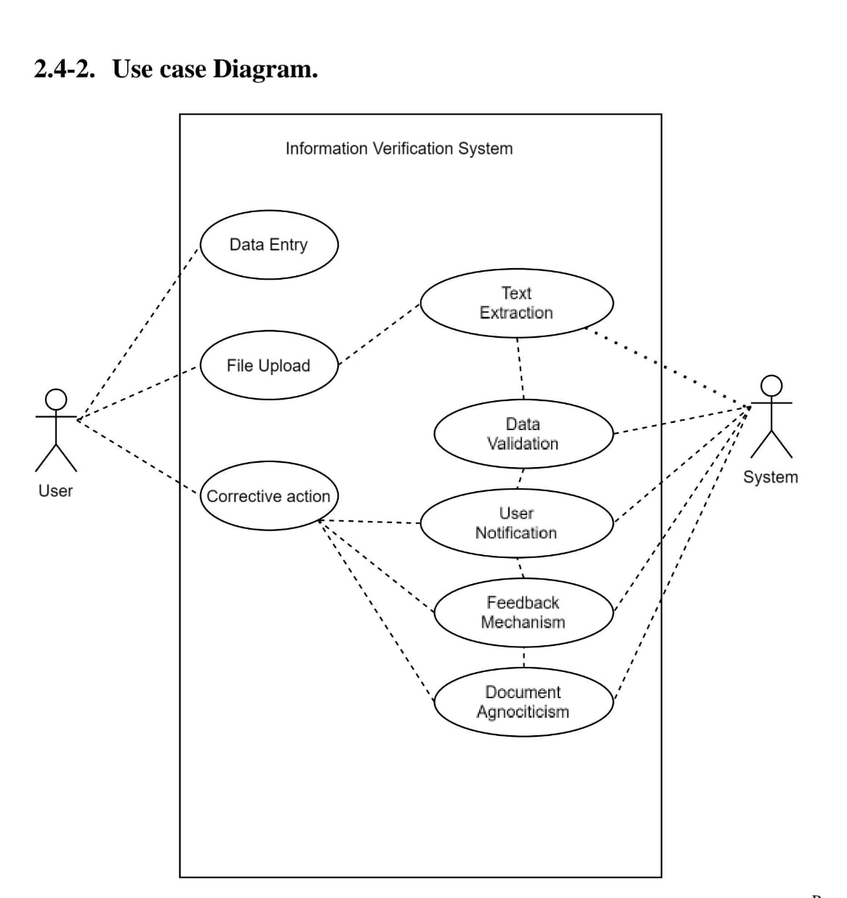
Use Case Diagram

Slide 10
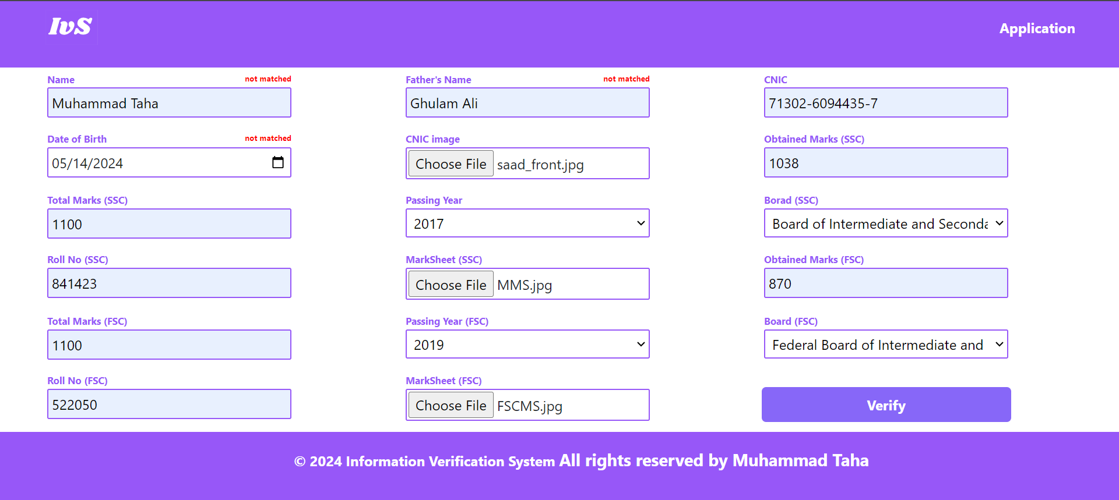
Interface Image

Slide 11
05.
VERIFICATION PROCESS

Slide 12


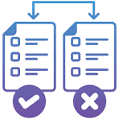
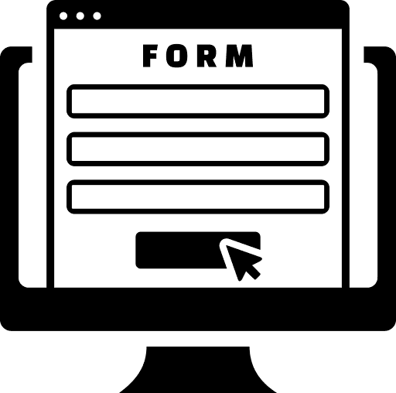

Veficication Process
Text
extraction
Upload
Documents
Extracted
data
Uses Website
Notification
Compare
Data
Form data
Input data
Corrective
actions

Slide 13
06.
TOOLS & TECHNIQUES

Slide 14




Tools & Techniques
Django
Pytesserect
For implementing back-end
For text extraction
REACT.JS
PostgreSQL
For designing
front-end
For storing data

Slide 15
07.
SUMMARY

Slide 16

Summary
Our web app provides comprehensive functionalities covering user registration, data entry, document uploading, text extraction, data validation, user notification, corrective action, and intuitive UI ensure a robust solution for verifying information efficiently.

Slide 17
08.
FUTURE WORK

Slide 18

Future Work
Machine Learning Document Authentication.
Extended Document Format Support.
Multilingual Data Extraction.
Enhanced Image Processing.

Slide 19
08.
CONCLUSION

Slide 20

Conclusion
Efficient data extraction from English images for cross-verification.
Future plan includes expanding data collection and implementing ML models.
Commitment to providing a robust and reliable verification process.

Slide 21
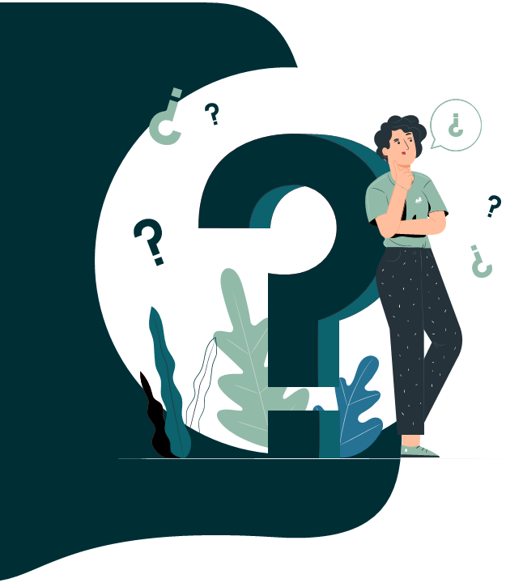
THANKS!
DO YOU HAVE ANY QUESTIONS?

